Slide 1


INSIGHTS ANALYTICS GROUP
Unleashing Insights Through Visuals
Presented by [Your Name], Data Visualization Expert and Consultant

Slide 2
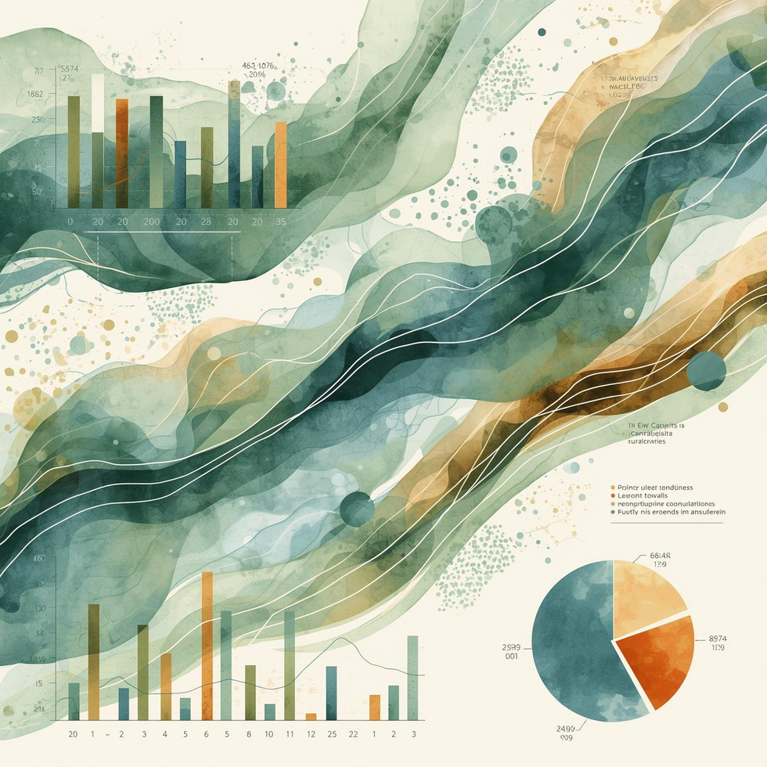
The Power of Data Visualization
Data visualization plays a crucial role in professional environments, enabling clear communication and informed decision-making. By presenting complex data through engaging visuals, it enhances understanding and retention. The evolution of data visualization has made it essential in today’s analytics landscape, empowering professionals to convey insights effectively and influence outcomes. Embracing this tool fosters a culture of data-driven decision-making.

Slide 3
Key Principles
01
Clarity
Visualizations should present data clearly, enabling the audience to understand insights without confusion.
02
Accuracy
Ensure data is represented accurately, avoiding distortions that could mislead the audience's interpretations.
03
Simplicity
Strive for simplicity in design, eliminating unnecessary elements that distract from the message being conveyed.

Slide 4

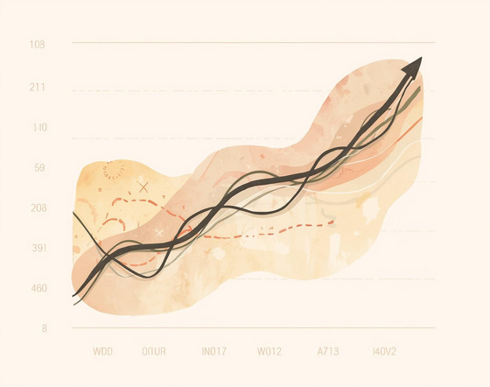

Choosing the Right Chart Types
Bar Charts
Line Charts
Pie Charts
Effective for comparing quantitative values across categories.
Ideal for showing trends over time with clarity.
Useful for illustrating proportions within a whole visually.

Slide 5

Common Pitfalls
In data visualization, avoiding common pitfalls is essential for effective communication. Misleading scales, cluttered designs, and overcomplicated charts can obscure critical insights. It's crucial to simplify visuals while ensuring clarity and accuracy. By focusing on the story behind the data and integrating organic design elements, professionals can create impactful visualizations that enhance understanding and support informed decision-making in their projects.

Slide 6
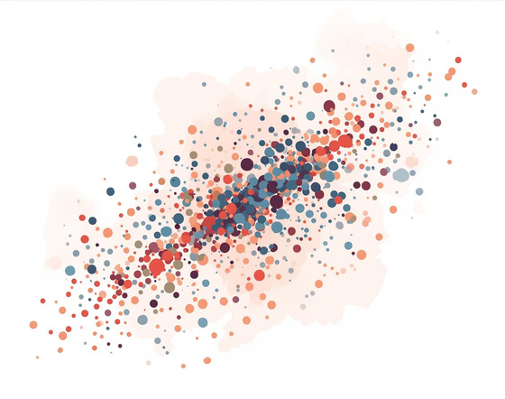


Exploring Popular Chart Types
Scatterplots
Heatmaps
Dashboards
Show relationships between variables using dots.
Visualize data density through color variations.
Integrate multiple visualizations for comprehensive insights.

Slide 7

Advanced Visualizations
Geographic maps, network graphs, and infographics are powerful tools for presenting complex data. Geographic maps offer spatial insights by relating data to locations, while network graphs illustrate relationships and connections in data. Infographics combine visual elements and text to convey information engagingly and clearly, making these advanced visualizations essential for professionals seeking to communicate data effectively and creatively in their presentations.

Slide 8



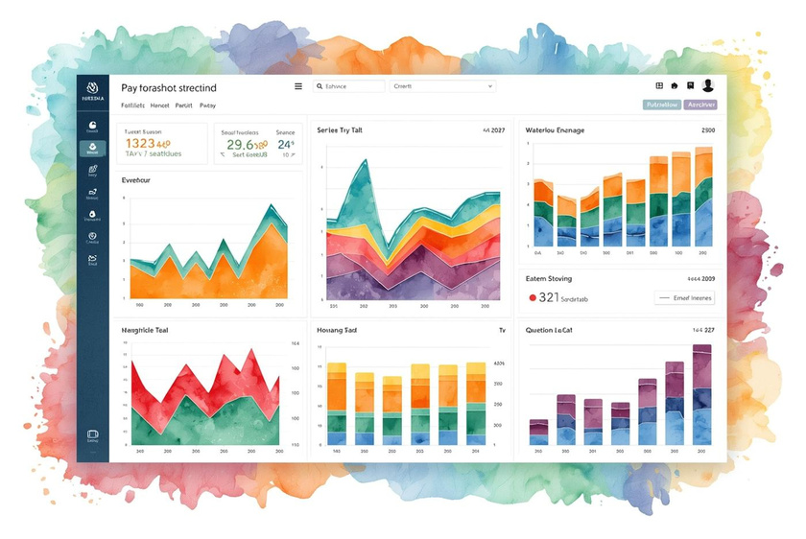
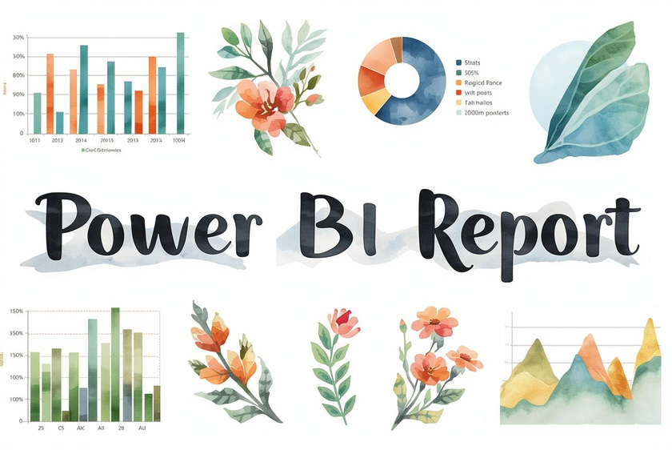


Tableau
Power BI
D3.js
A leading platform for interactive data visualization.
Microsoft’s powerful tool for business analytics insights.
A JavaScript library for dynamic data-driven visualizations.
Interactive Dashboards
Business Analytics
Dynamic Visuals
Engaging visualizations that facilitate data exploration.
Insights derived from real-time data analysis tools.
Innovative representations that enhance data storytelling.

Slide 9

Real-World Use Cases
Effective data visualization transforms complex datasets into clear insights. By leveraging engaging displays, professionals can communicate findings that drive strategic decisions. For instance, dashboards showcasing key performance indicators allow stakeholders to grasp trends quickly. Real-world examples highlight how companies utilize visualizations to enhance understanding and foster collaboration, ensuring that data informs decision-making processes in meaningful, impactful ways.

Slide 10

Value of Visualization
The value of data visualization lies in its ability to transform complex data into easily digestible formats. Effectively designed visuals not only enhance understanding but also foster better decision-making. By adhering to core principles like clarity and simplicity, professionals can communicate insights and narratives that drive action, ultimately unlocking the potential of their data in impactful ways.

Slide 11
Next Steps
01
Training Resources
Invest in online courses to deepen your understanding of data visualization techniques and best practices.
02
Tool Trials
Experiment with leading software like Tableau and Power BI to enhance your visualization capabilities and workflow.
03
Applying Best Practices
Implement key principles of clarity and simplicity in your projects to elevate your data storytelling effectiveness.

Slide 12

Let's Connect
YOUR FEEDBACK MATTERS
123 Anywhere St., Any City, ST 12345
123-456-7890
hello@reallygreatsite.com

